Slide 1


LIBRARY MANAGEMENT SYSTEM
Presented By
Apoorva

Slide 2
PROBLEM STATEMENT
To devise software for providing the information and simplifies the procedure to renew and search books

Slide 3
INTRODUCTION
This project is dedicated to-
Simplify the Library Procedure.
To provide a comprehensive set of set of features.
Evaluate their functions in different scenarios.
Suggest modification for greater efficiency

Slide 4
Existing system
Fast report generation is not possible.
Tracking a book is difficult.
Information about the issue or return of the book is not maintained properly.

Slide 5
Proposed work
It provides better and efficient service to users.
Reduces the workload.
Faster retrieval of information about the desired book.
Provide facilities for proper monitoring, reduce paperwork.
All details will be available on click.
Be quick and more efficient.

Slide 6
Key functions
Student_Registration()
Add_Book()
Search_Book()
Book_Details()
Issue_Book()
Issued_Book()
Return_Book()

Slide 7
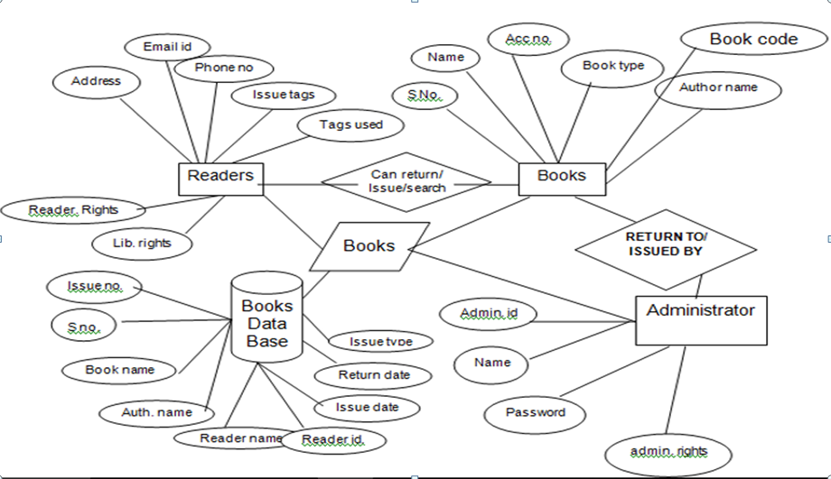
ER Diagram

Slide 8
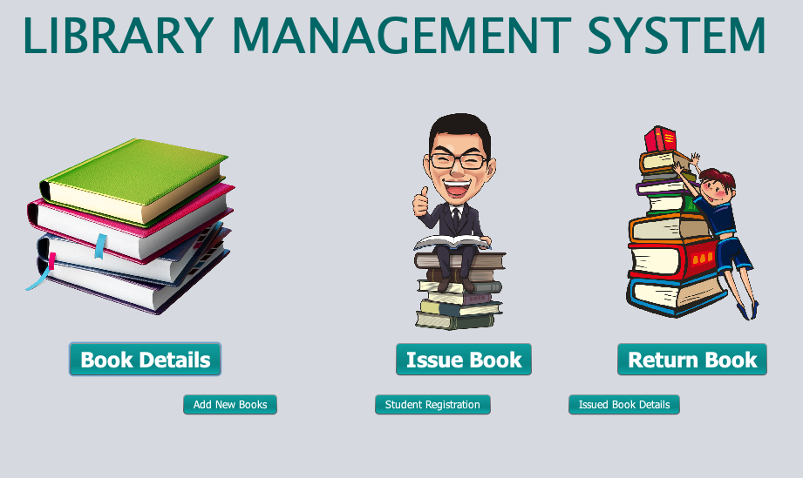
Graphical User interface

Slide 9
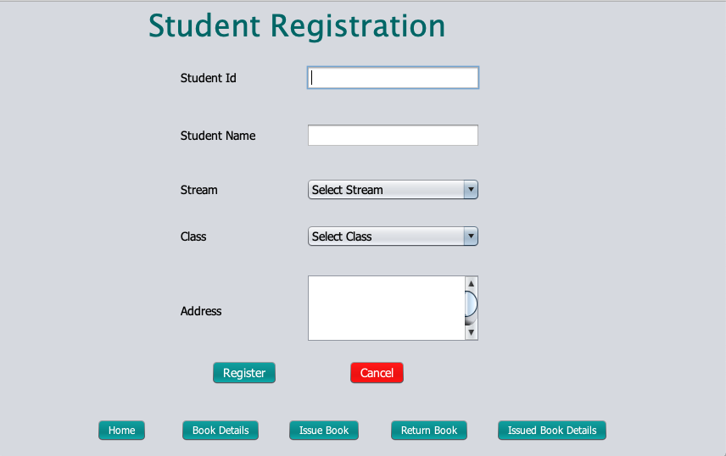
Student Registration Page

Slide 10
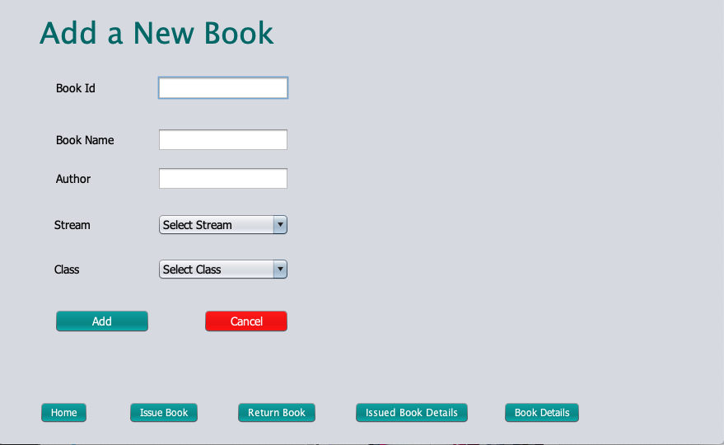
Add new Book

Slide 11
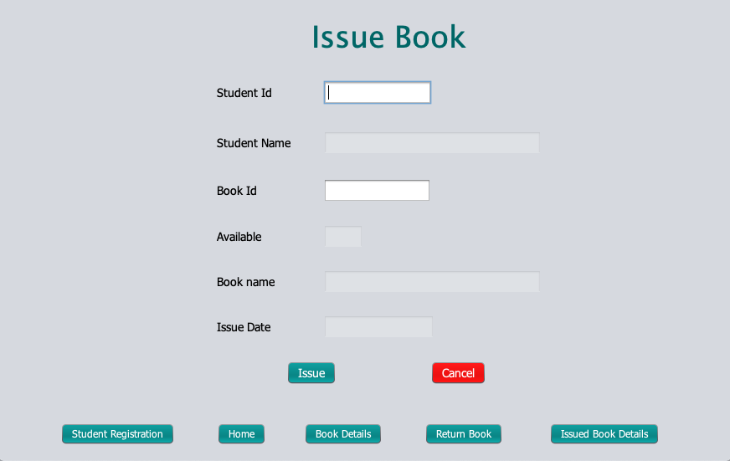
Issue book to student

Slide 12
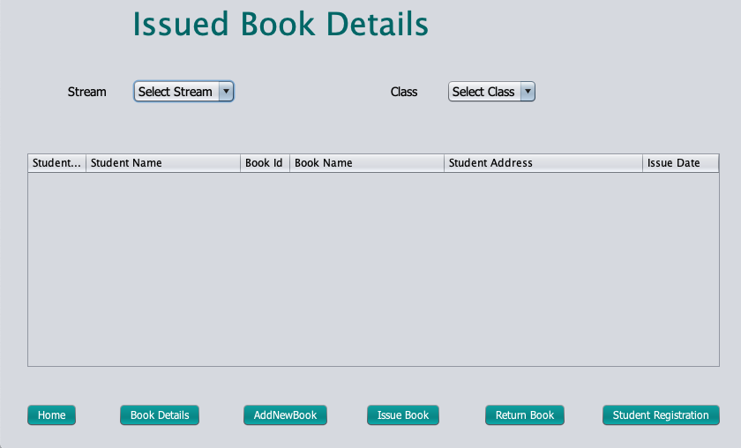
Issued book details

Slide 13
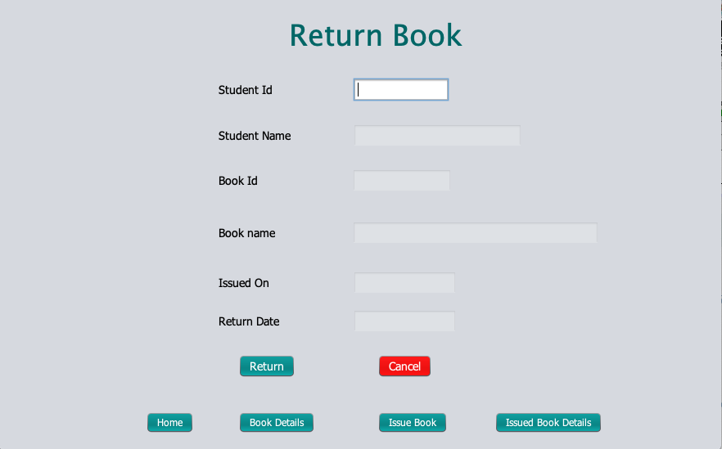
Return book

Slide 14
Conclusion
It reduces the paper work.
It maintains the potentially vast mount of books held in the library.
It reduces human effort.
It reduces time span.

